Slide 1
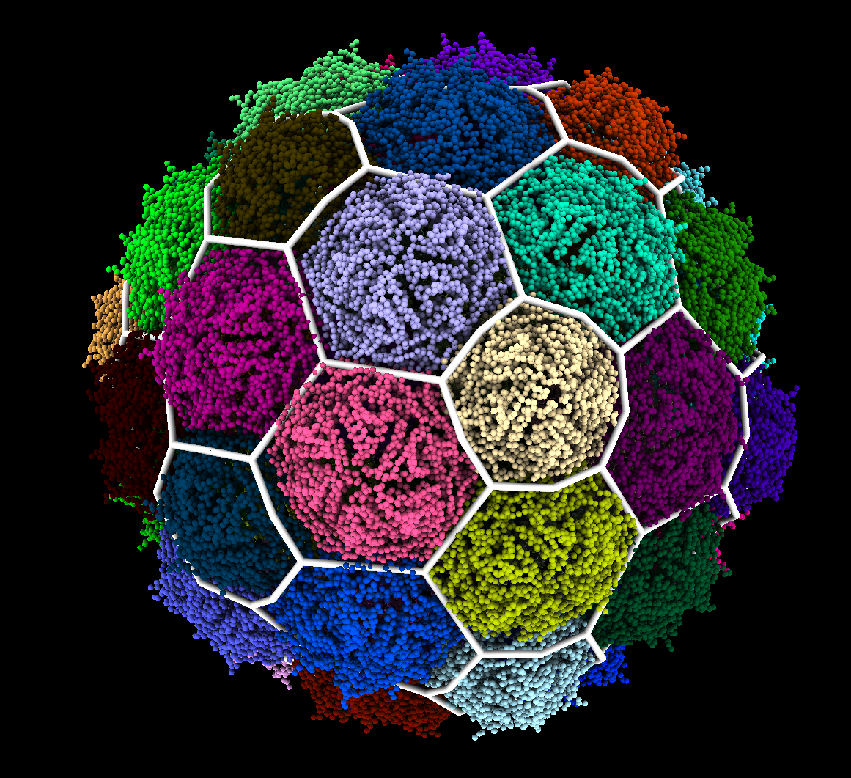
Classification Of Icosahedral Capsids Via Quasi-Rigid Domain Decomposition

Slide 2
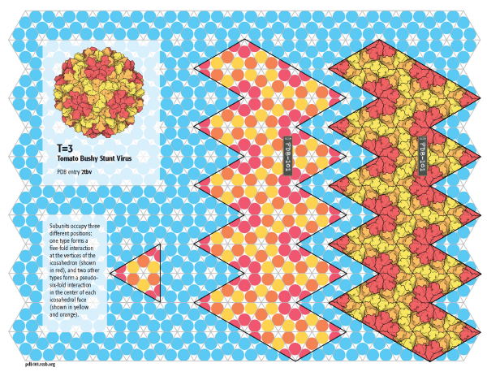
Icosahedral Capsids
Protein shell that contains the genome
Built from repeating units called Major Capsid Proteins (MCPs) in quasi-equivalent positions
Exhibit the 5-3-2 rotational symmetry of an icosahedron
MCP organization follows one of 8 2D lattices

Slide 3
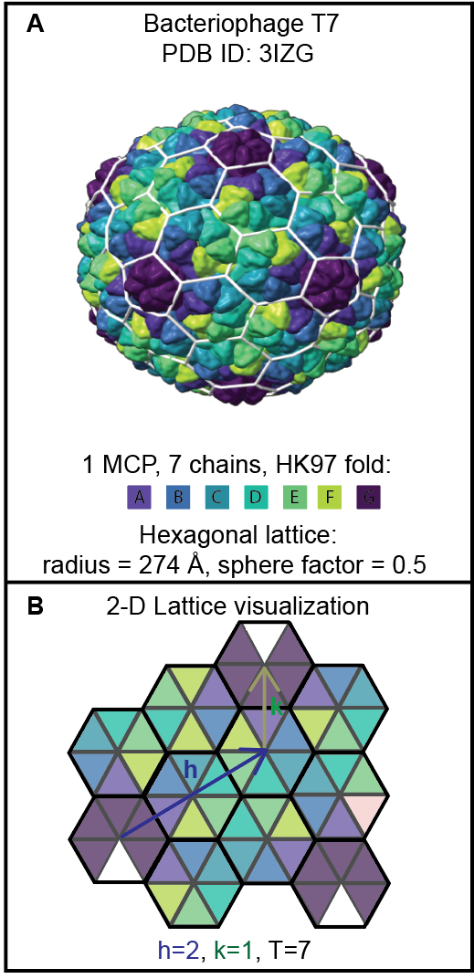
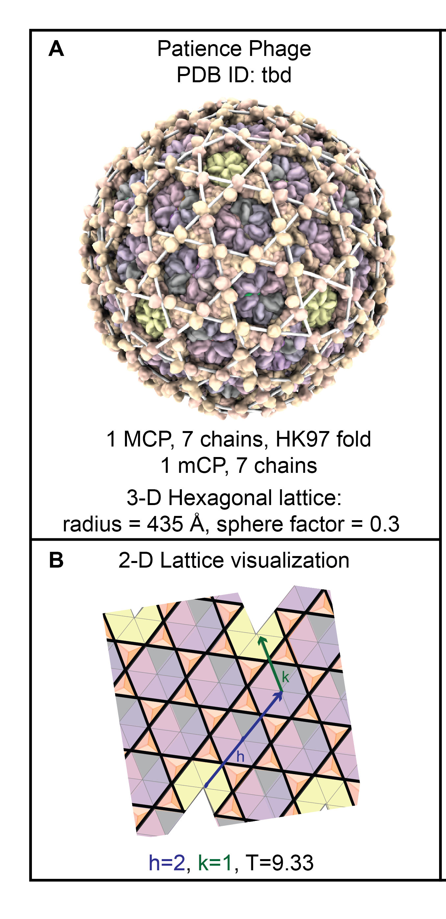
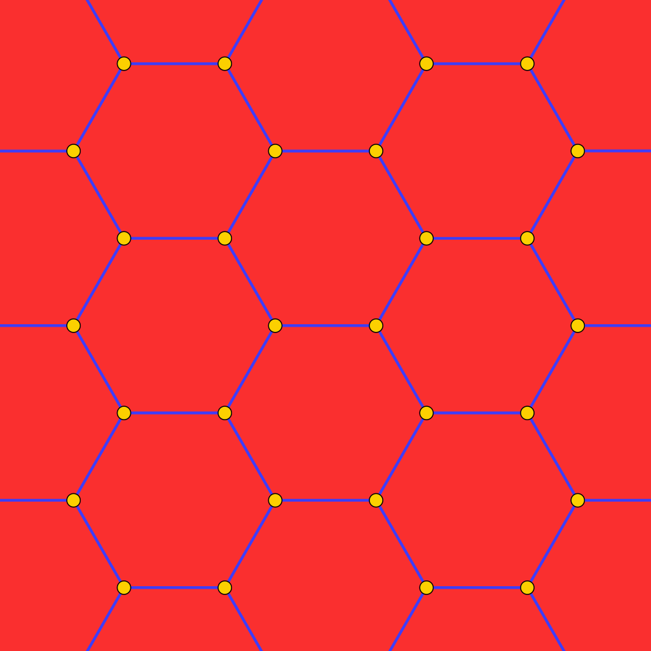
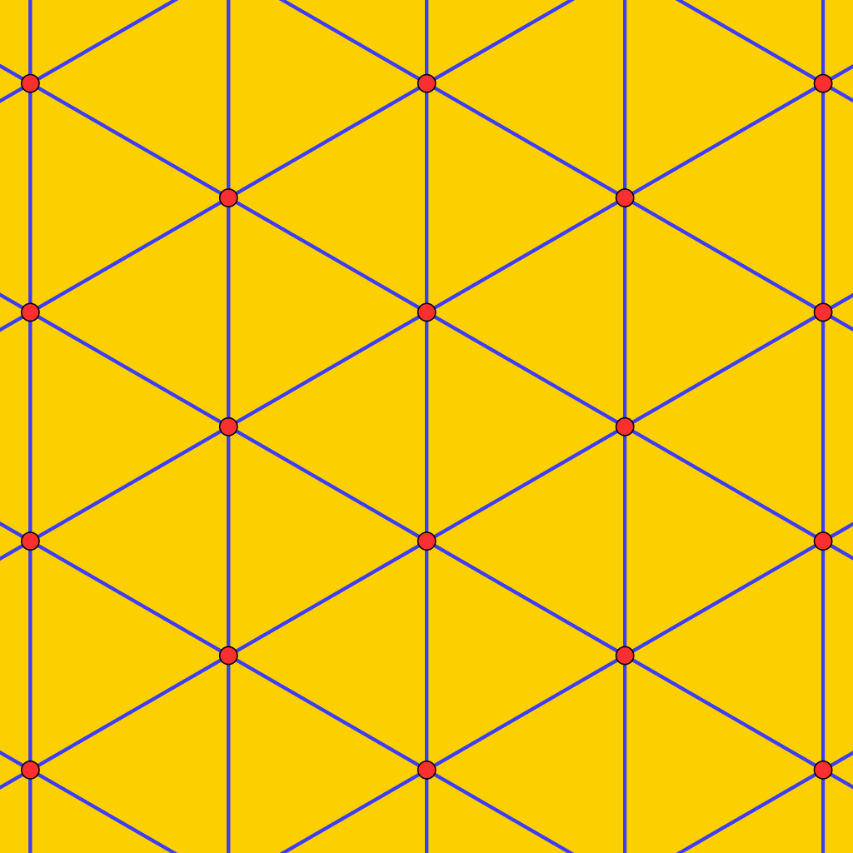
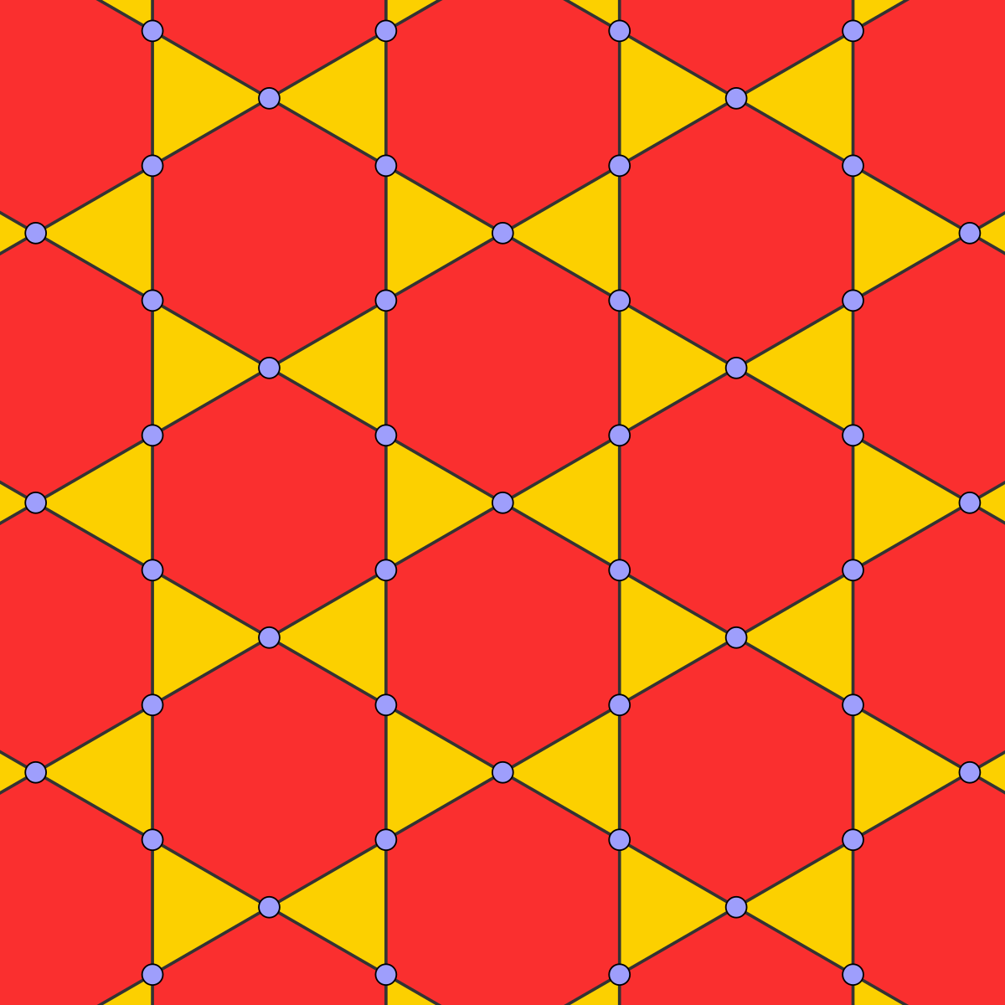
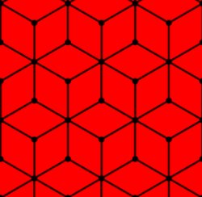
Classifying Icosahedral Capsid Geometry
T Number – 60*T MCPs in a capsid
Lattice – Polygons represent multimers called capsomer
Capsomers are ambiguous, MCPs could be grouped into trimers, dimers, or hexamers
4 Most Common Lattices

Slide 4
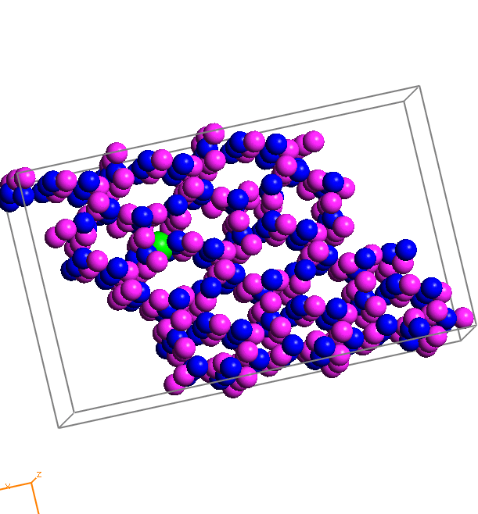
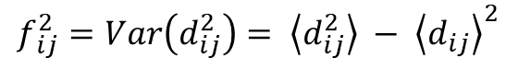
Augmenting The Classification
Assumption: Capsomers are Quasi-Rigid Subunits
Mechanical not geometric
No ambiguity in choice of multimer
Recognizes non-MCP subunits
Requires extensive data or a physical model
$$f_{ ij}^{2}=Var\left(d_{ij}^{2}\right)= \left\langle d_{ij}^{2}\right\rangle − {\left\langle d_{ij}\right\rangle }^{2}$$

Slide 5
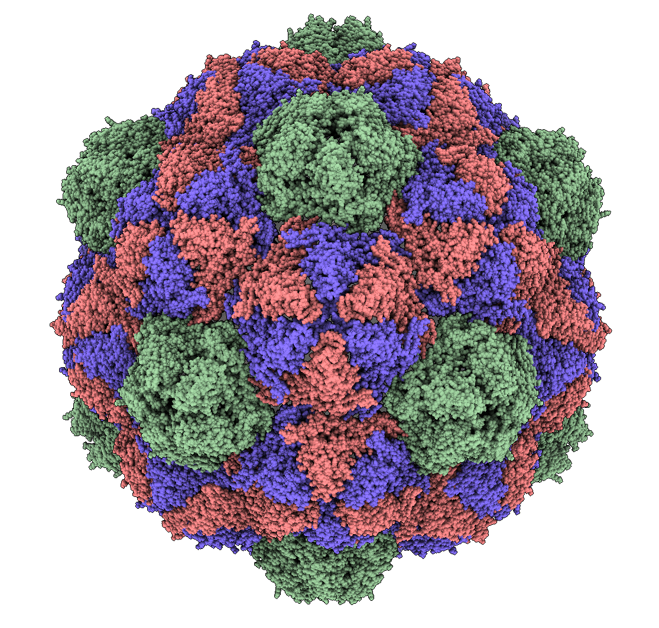
Quasi-Rigid Domain Decomposition
We implement the method described in (Ponzoni & Polles 2015) to identify quasi-rigid domains
Requires an atomic model of the full capsid
Previously applied only to small capsids and protein complexes
Our implementation targets large viral capsids and incorporates symmetry constraints to improve performance
Pyrococcus Furiosus VLP Capsid
(2e0z)

Slide 6
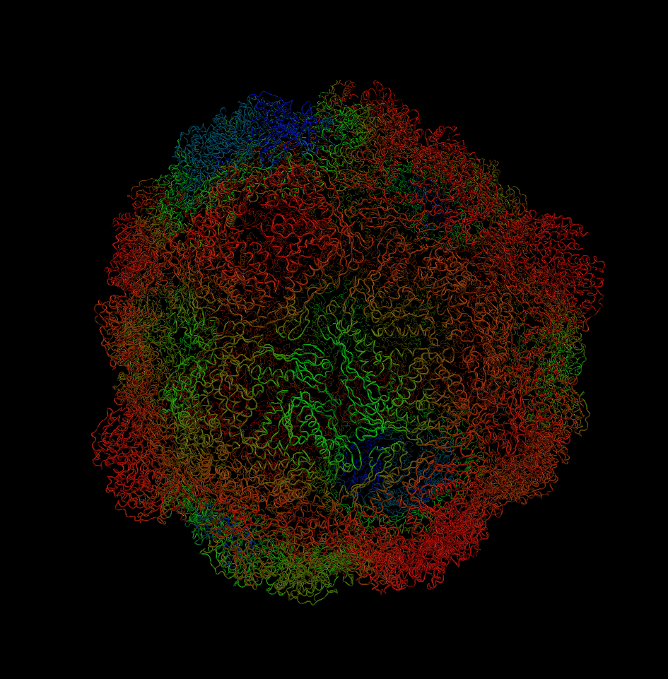
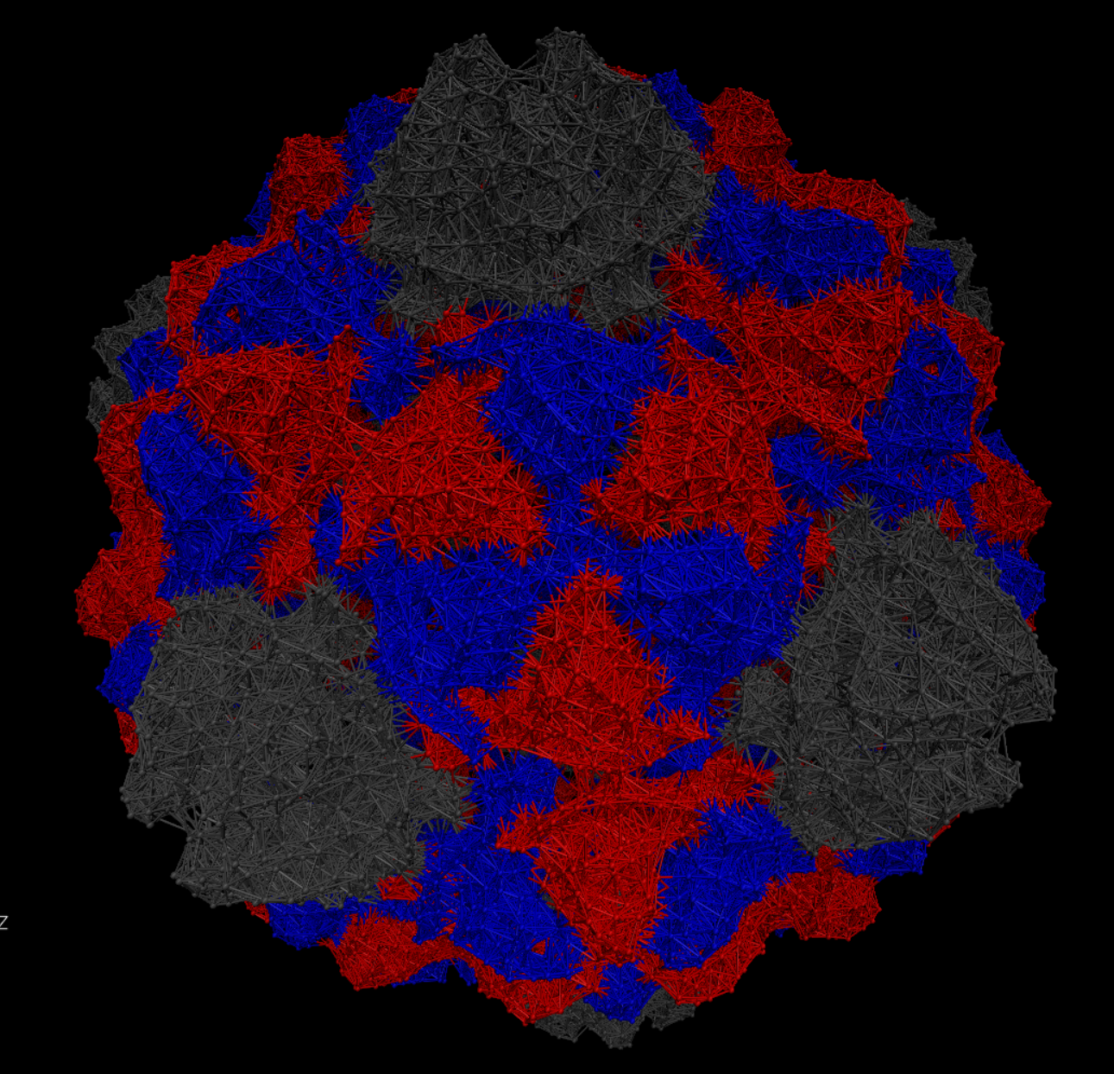
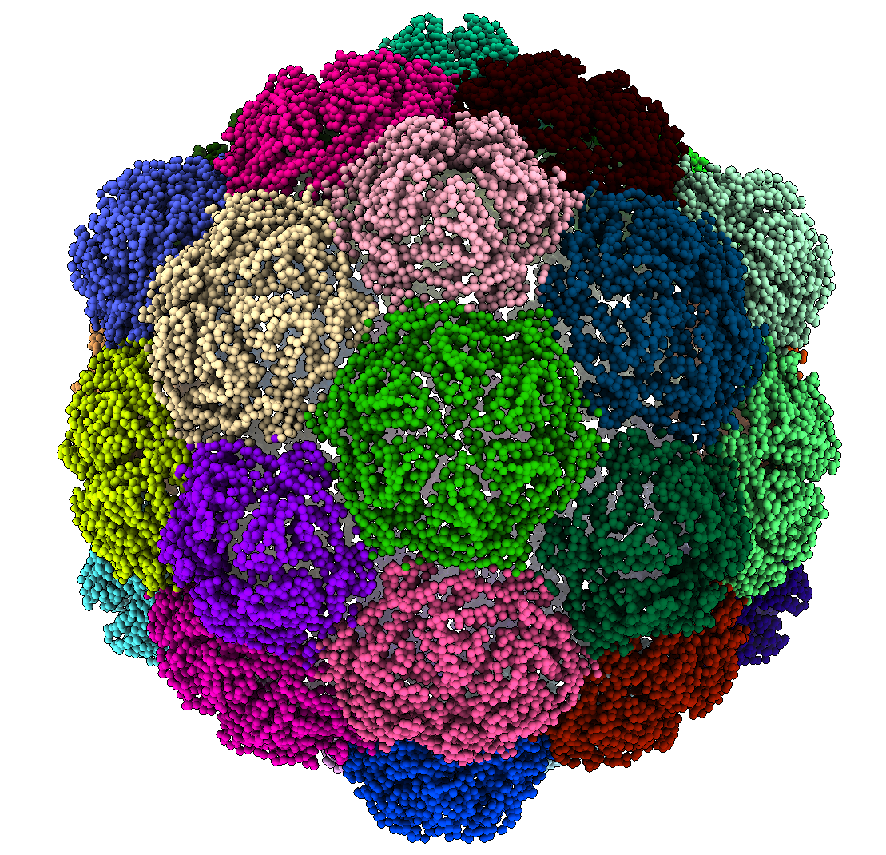
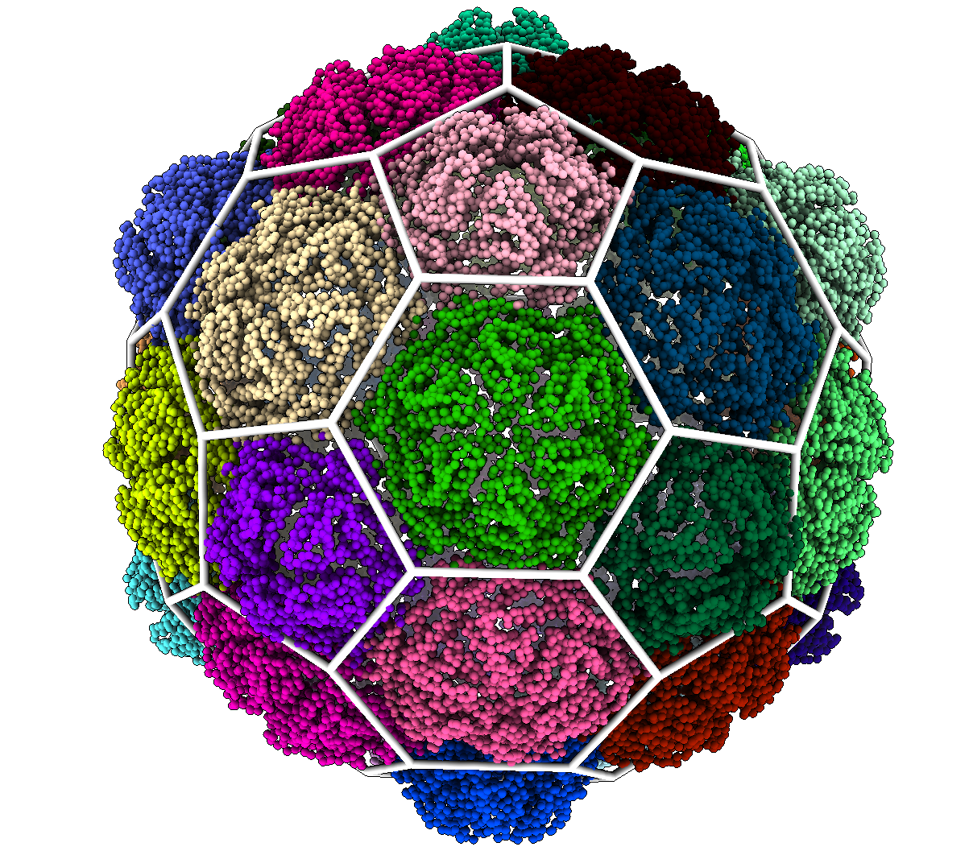
Domain Decomposition Steps
a)
b)
c)
d)
Elastic Network Model
Normal Mode Analysis
Subdivision
Classification

Slide 7
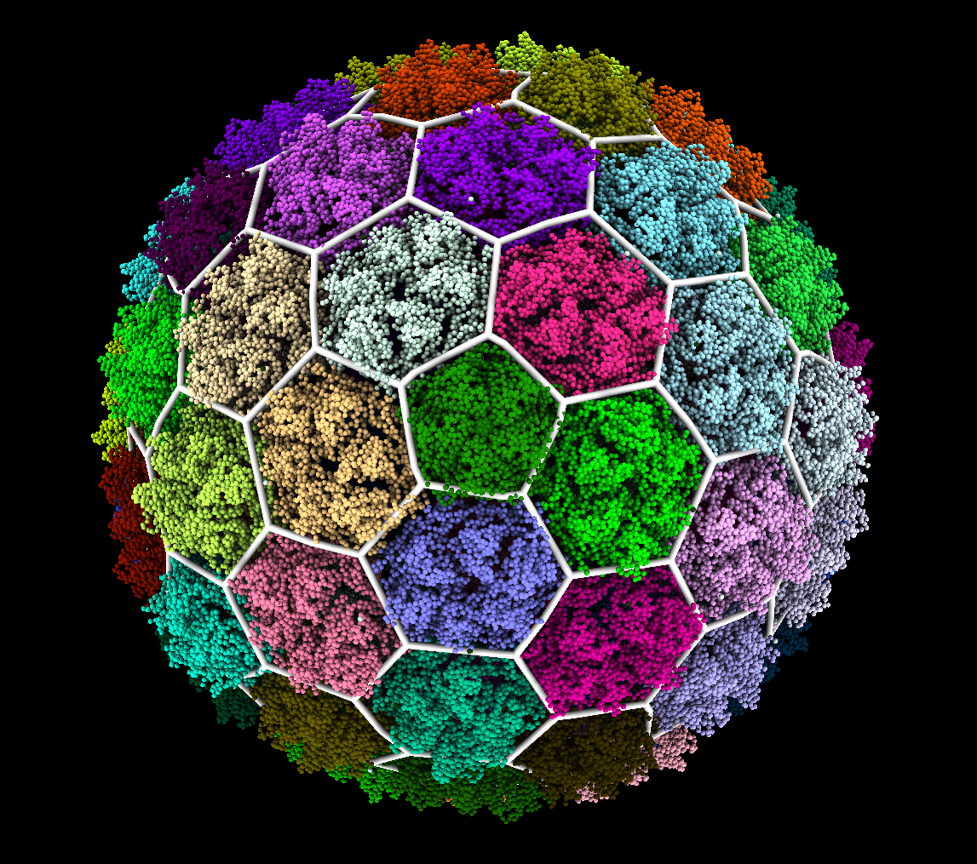

Visualization & Classification
The results are visualized in ChimeraX
Residues are colored by cluster membership
We overlay a 3D structure to assign a T number and Lattice

Slide 8
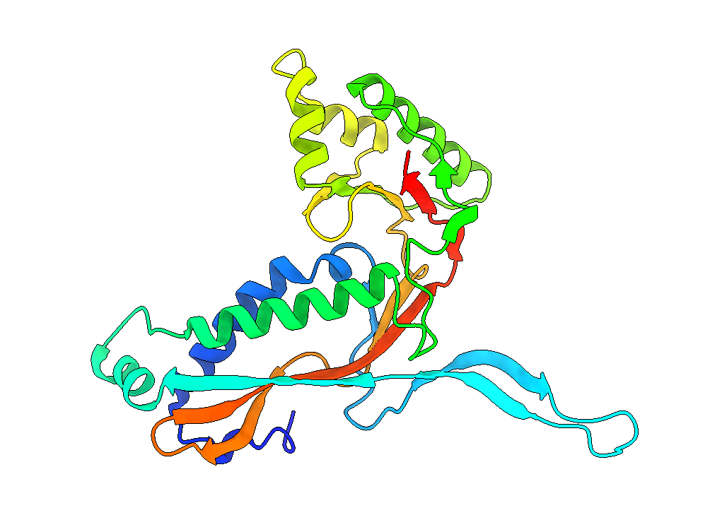
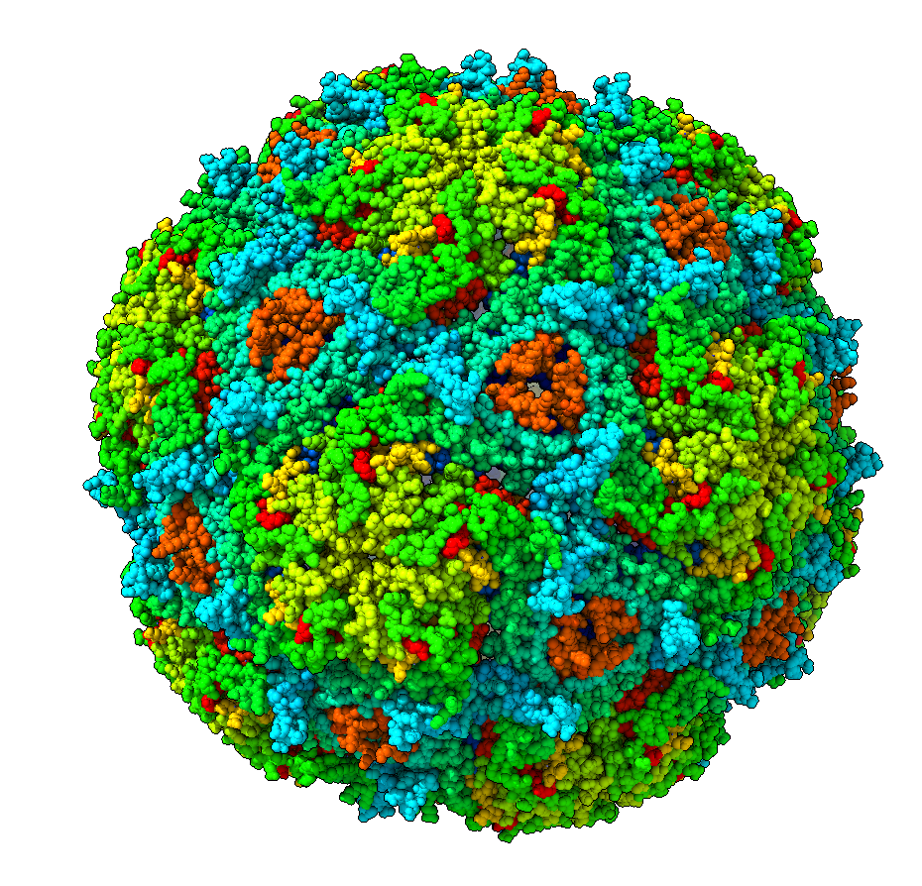
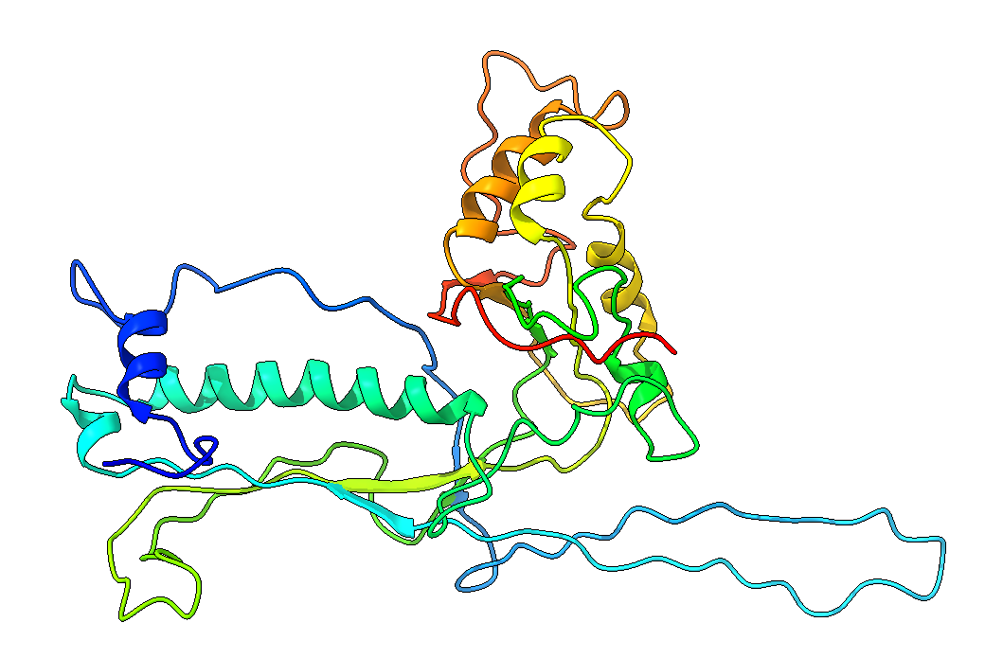
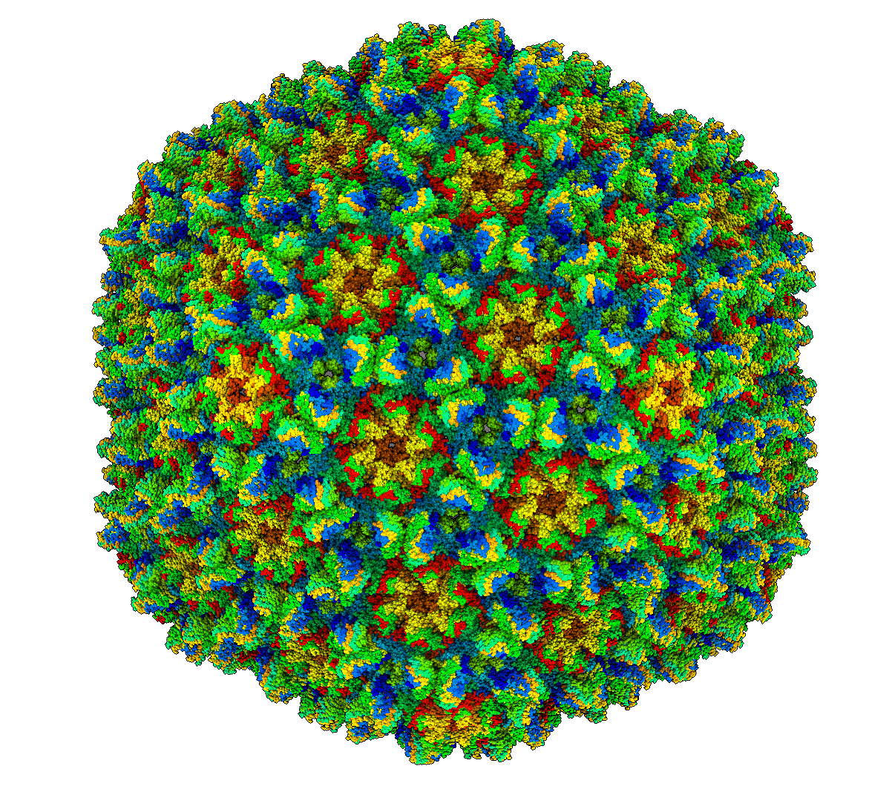
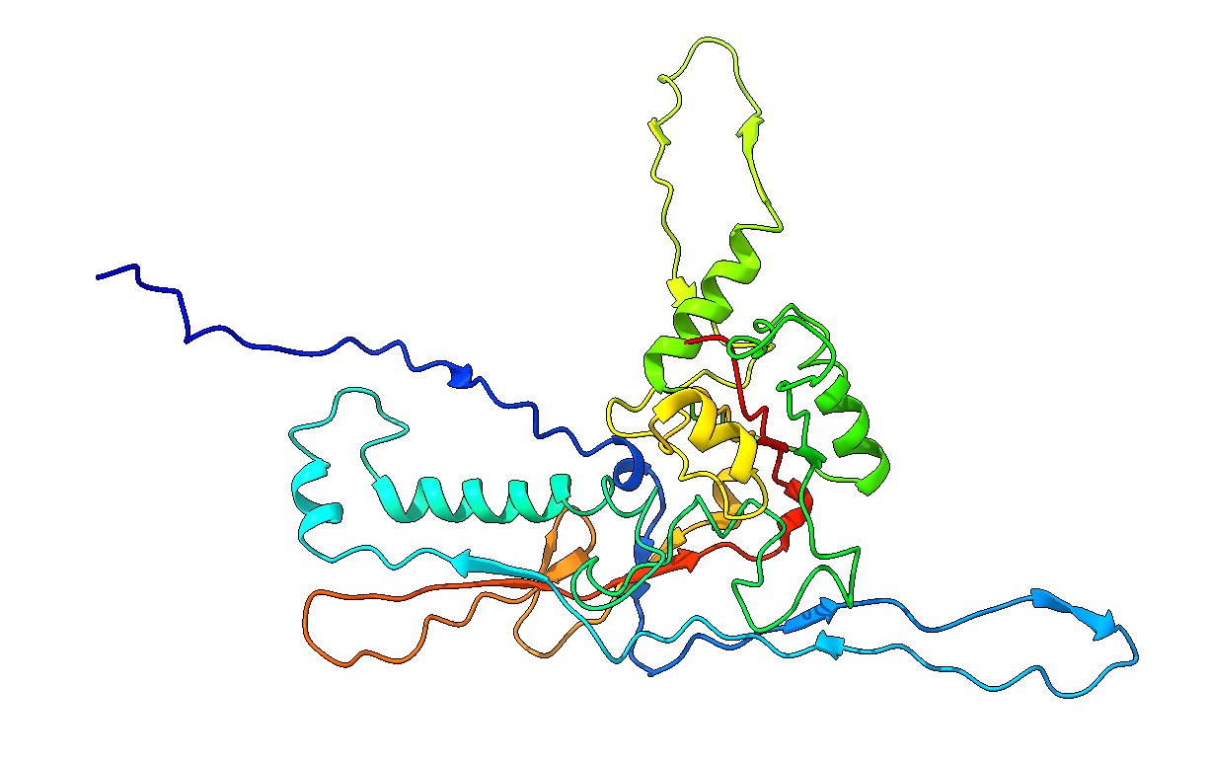
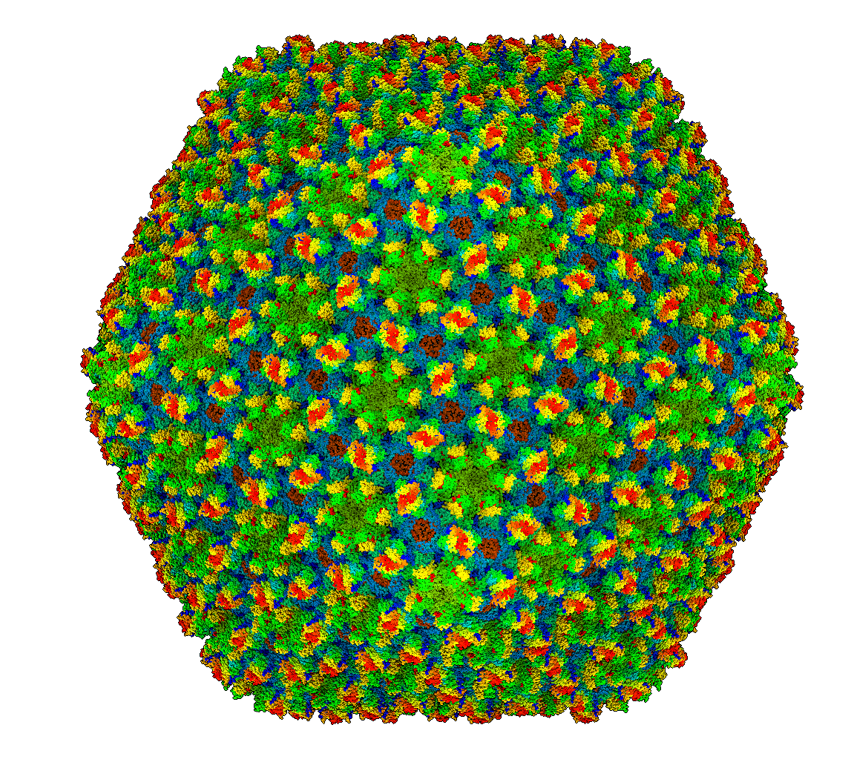
Application - HK97 Fold
Organism
MCP
Full Capsid
A common & versatile MCP fold
Variety in size and architecture
From T=1 to T=52
Can incorporate Reinforcement Proteins and minor Capsid Proteins
Thermotoga Maritima Encapsulin
Bordetella Bacteriophage
Freshwater Cyanophage Siphoviridae Mic1

Slide 9
Results
Capsid | T # | Additional Proteins | Result
Th. Maritima | 1 | None | Hexagonal
Pyr. Furiosus | 3 | None | Hexagonal
Myx. Xanthus | 3 | None | Hexagonal
Quasi. Thermo. | 4 | None | Hexagonal
P22 Mature | 7 | None | Hexagonal
Phage Sf6 | 7 | None | Hexagonal
Phage T7 | 7 | None | Hexagonal
Bordetella | 7 | 2-Fold Axis | Trihex-dual
Siphov. Mic1 | 7 | 2-Fold Axis | Trihex-dual
Sipho. TW1 | 7 | 3-Fold Axis | Trihexagonal
YSD1 Phage | 7 | 3-Fold Axis | Trihexagonal
Sipho TW1 | 13 | 2-Fold Axis | Trihex-dual
12 HK97 Capsids
7 Hexagonal
2 Trihexagonal
3 Trihexagonal-dual
Without reinforcement proteins HK97 capsids are hexagonal
Reinforcement proteins at the 2-fold and 3-fold axes of symmetry indicate a trihex-dual or trihexagonal result

Slide 10
Discussion & Conclusion

Slide 11
END

Slide 12
Quasi-Rigid Domain Decomposition
We implement the method described in (Ponzoni & Polles 2015) to identify quasi-rigid domains
Represent the capsid using an Elastic Network Model (ENM)
Apply Normal Mode Analysis to approximate the pairwise distance fluctuations between residues
Use Spectral Clustering techniques to optimally divide the capsid into quasi-rigid domains
Visualize the result and assign a geometric classification based on the clusters

